Slide 1

FINAL PROJECT
Mingxia Li NUID: 002765530
Yifei Chen NUID: 002749660

Slide 2
How to Manage Your Money Better
In everyday life, maintaining a balance in our finances is often a challenge. Many people find it difficult to remember each expense due to trivial purchases and complex daily outlays when trying to control their spending. In such situations, effective and convenient expense tracking becomes crucial. A clear record of expenditures not only helps us plan our finances reasonably but also prevents unconscious overspending on unnecessary items.
To address this issue, we developed Montrack. This application not only simplifies the process of recording expenses but also introduces a special feature: users can generate visual images of their financial records and share them with others. This innovation aims to add an element of fun to financial tracking, encouraging users to remain actively engaged.
Additionally, we understand the sensitivity and privacy of personal financial data. Therefore, we have incorporated a password lock feature in Montrack. Users are required to re-enter a PIN every time they switch from the background to the foreground, thus protecting their financial privacy. This feature ensures the confidentiality and security of user data.
With Montrack, we strive to help users manage their daily expenses in a simple, enjoyable, and secure way, achieving financial balance and security.

Slide 3
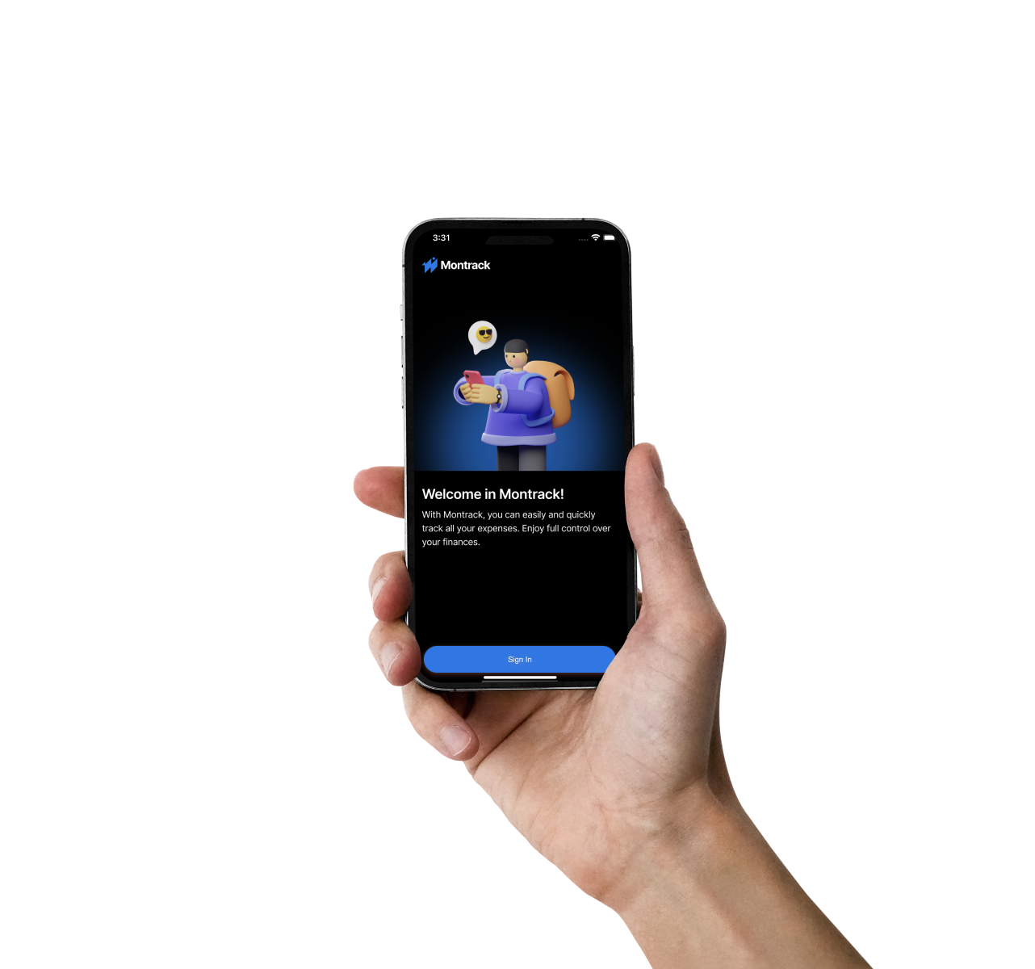
How to Manage Your Money Better
Minimalist Design
Intuitive User Experience
Privacy-Secure
Insightful Analytics
Reliable Performance
Notes:
Minimalist Design: The app boasts a sleek and uncluttered design, emphasizing simplicity and ease of use.
Intuitive User Experience: Offers straightforward and user-friendly interactions, making expense tracking efficient and hassle-free.
Privacy-Secure: Prioritizes user privacy with robust security measures, ensuring personal financial data is kept safe and confidential.
Insightful Analytics: Features thoughtful and detailed statistical charts, providing valuable insights into spending habits and financial trends.
Reliable Performance: Delivers stable and consistent app performance, ensuring a smooth and uninterrupted expense tracking experience

Slide 4
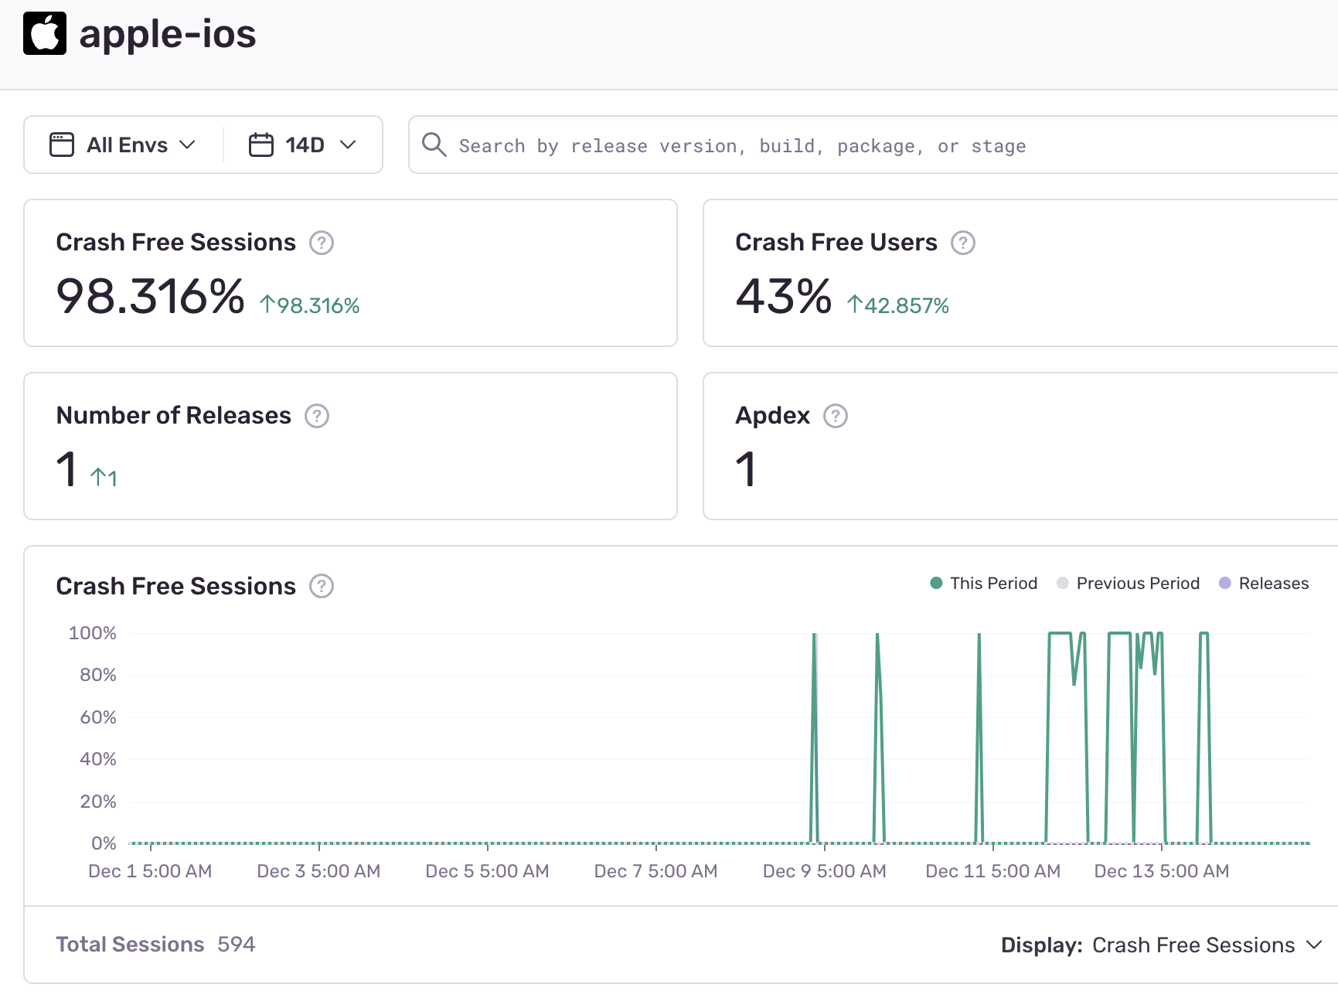
What technology stack did we use
iOS16+ / Swift5
UI part
Figma, SwiftUI
Database part
Realm SDK
Performance Monitoring
Integrated Sentry SDK -enabled for real-time error detection

Slide 5
What Functions We’ve Designed
Expense
User
Category
Sign Up
CRUD
Sign In
Search By Category
Create
Setup App Pin
Data Analytics
(Year/Month/Week)
Delete
App Pin Verification

Slide 6
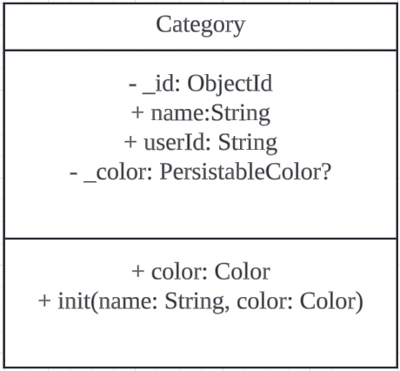
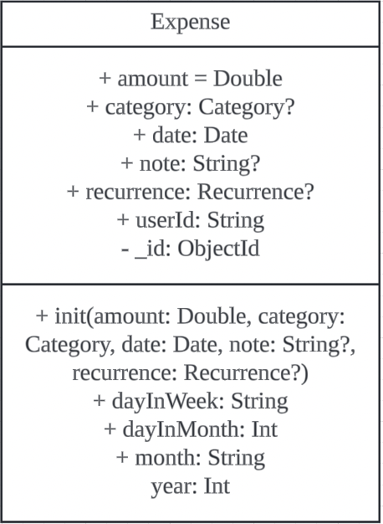
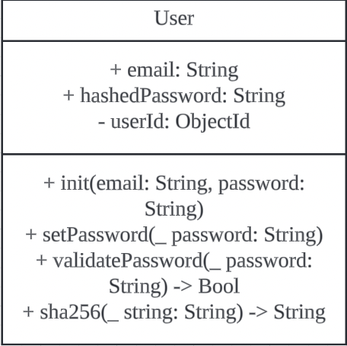
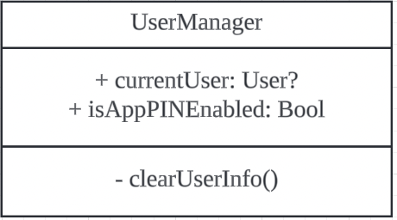
UML

Slide 7
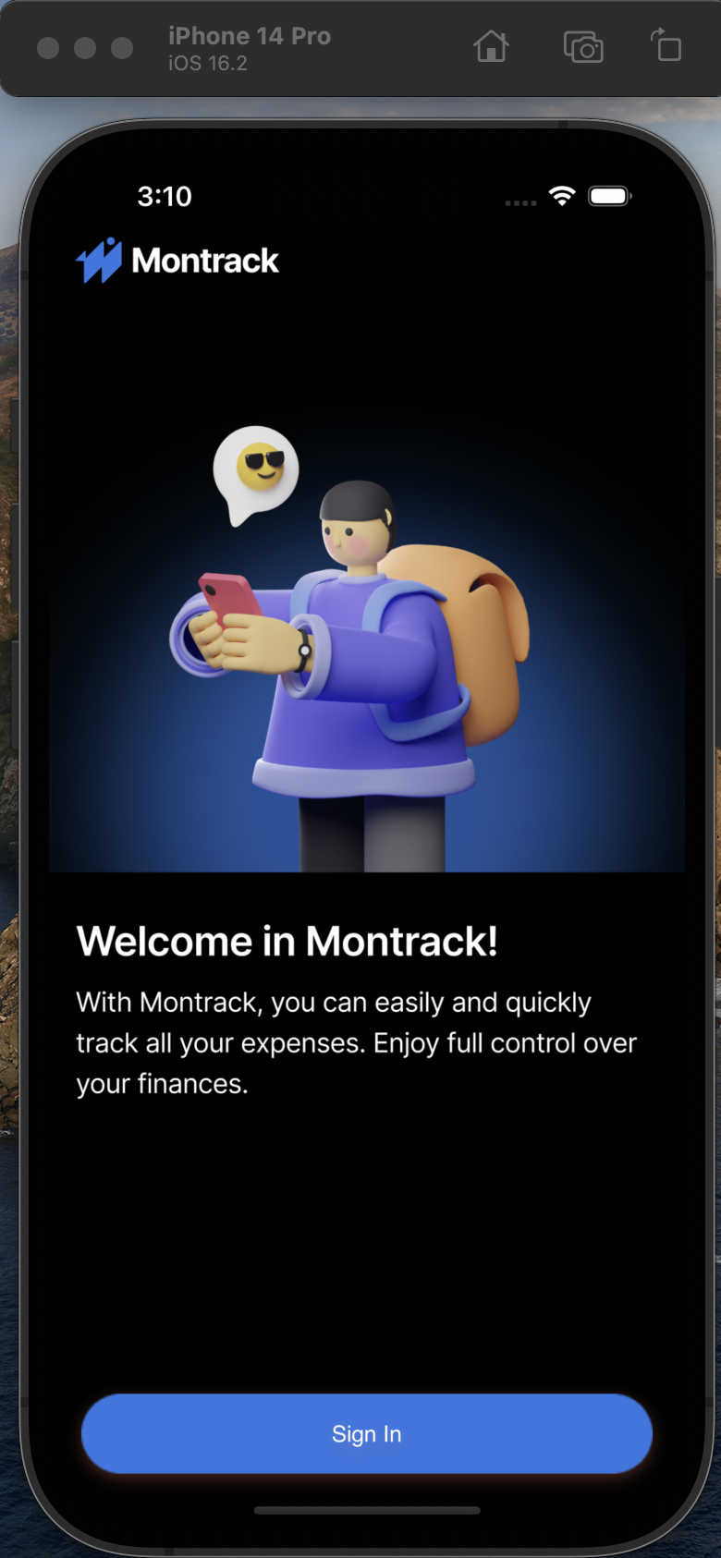
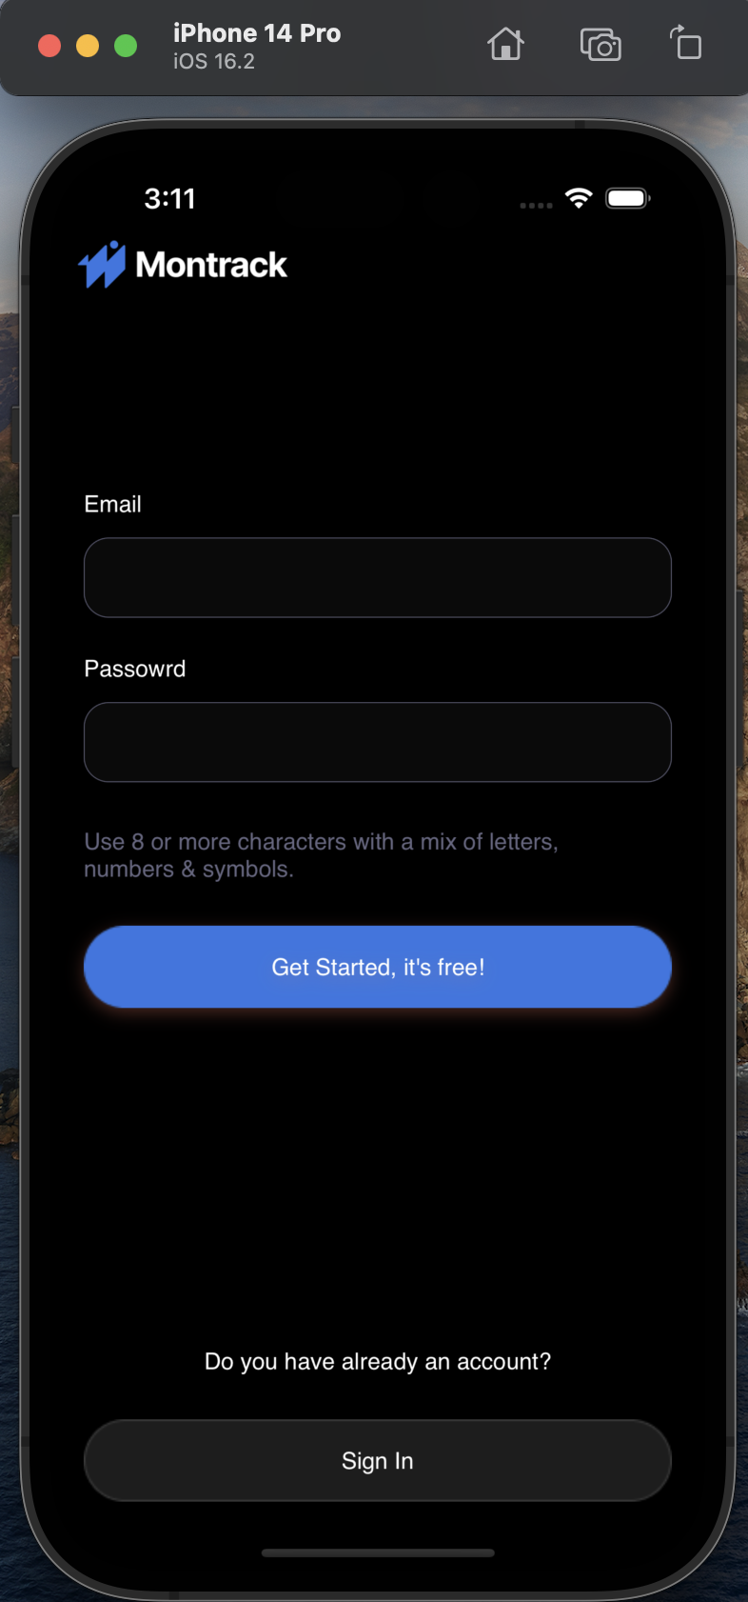
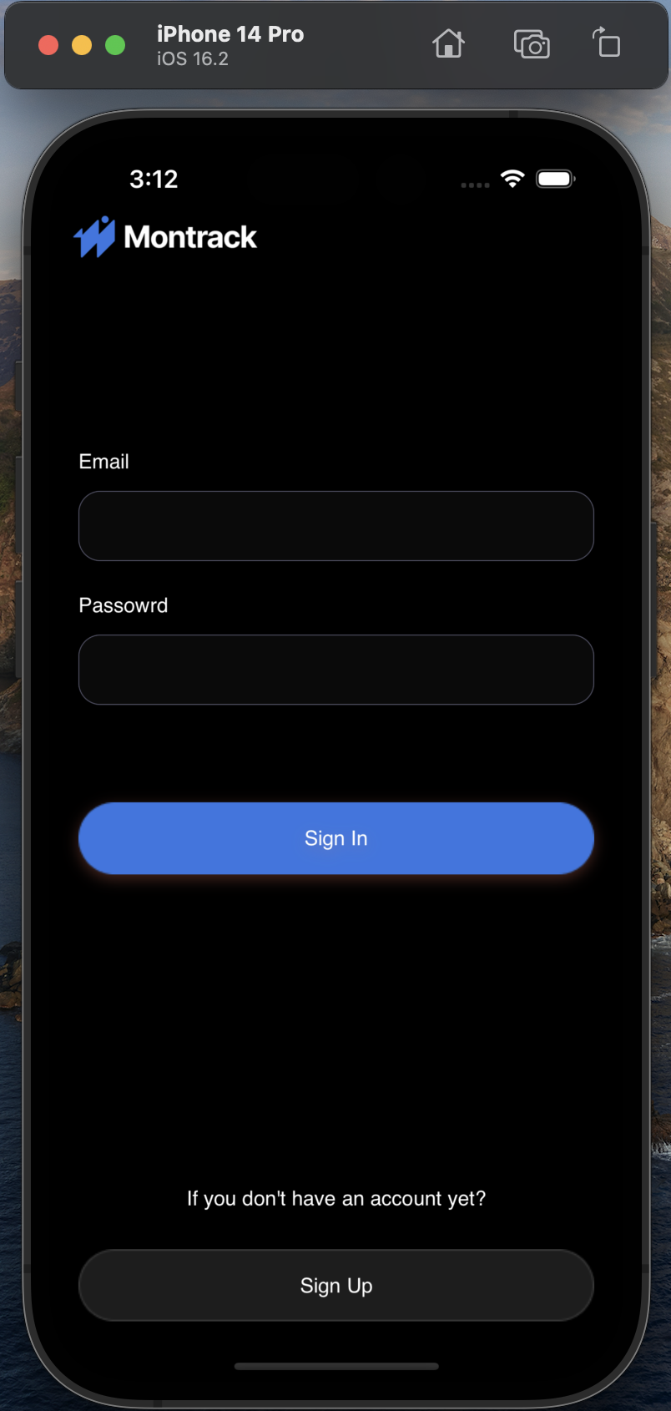
Sign Up Sign In

Slide 8
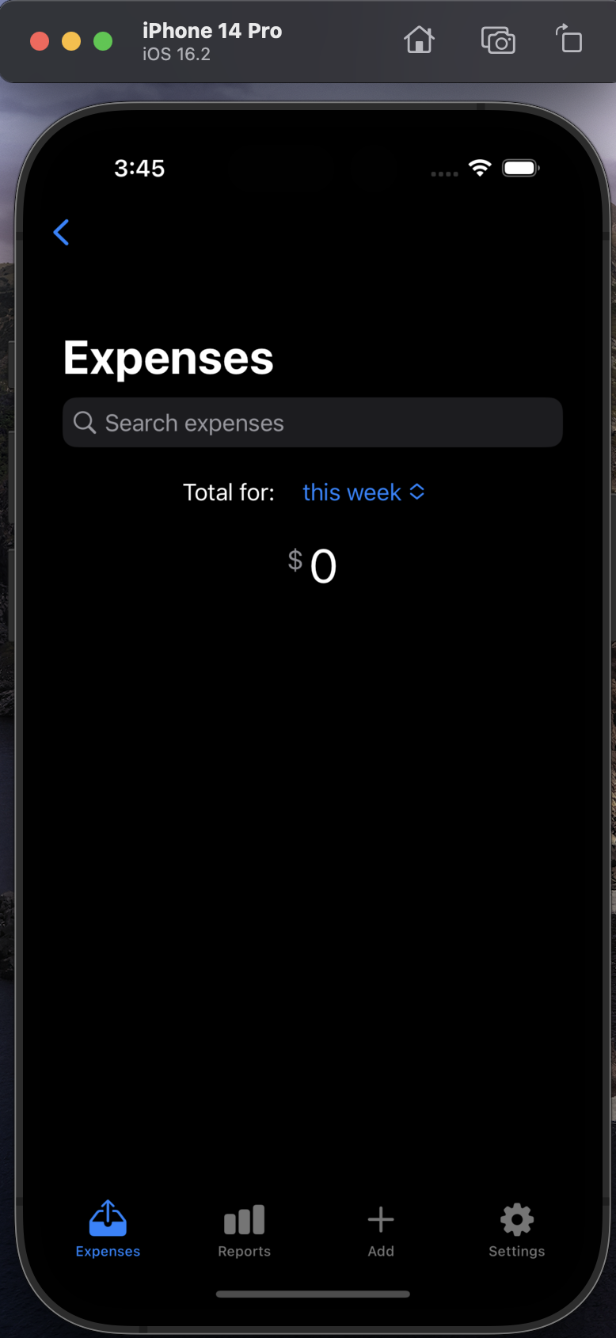
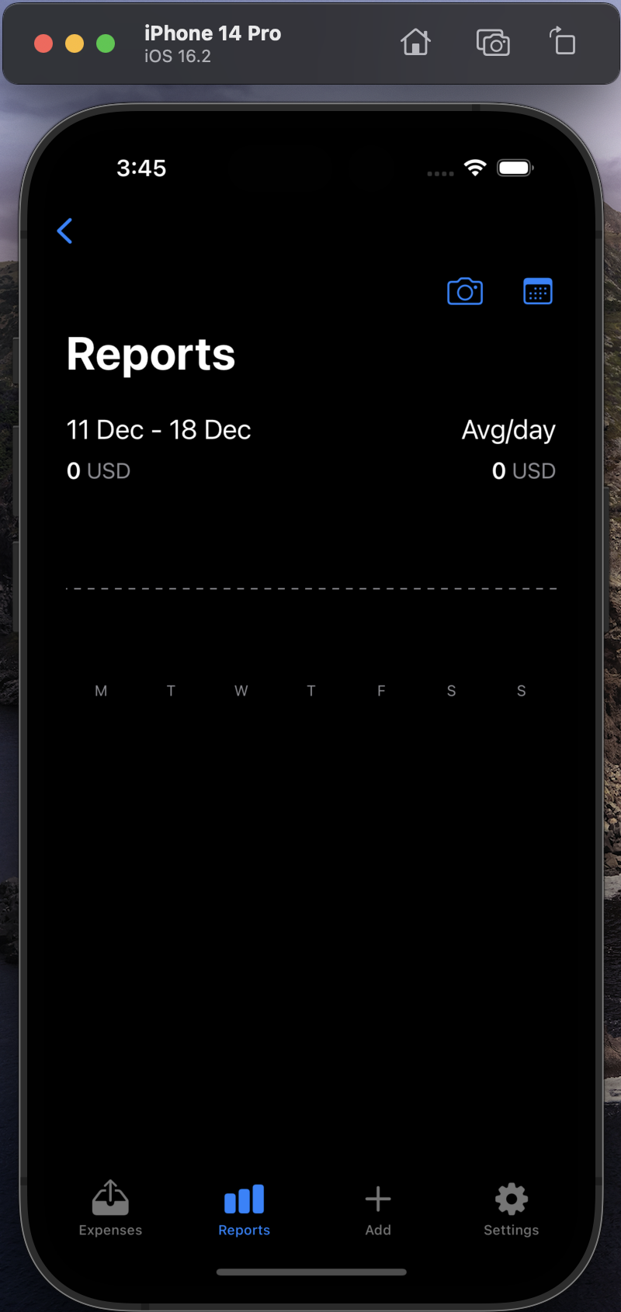
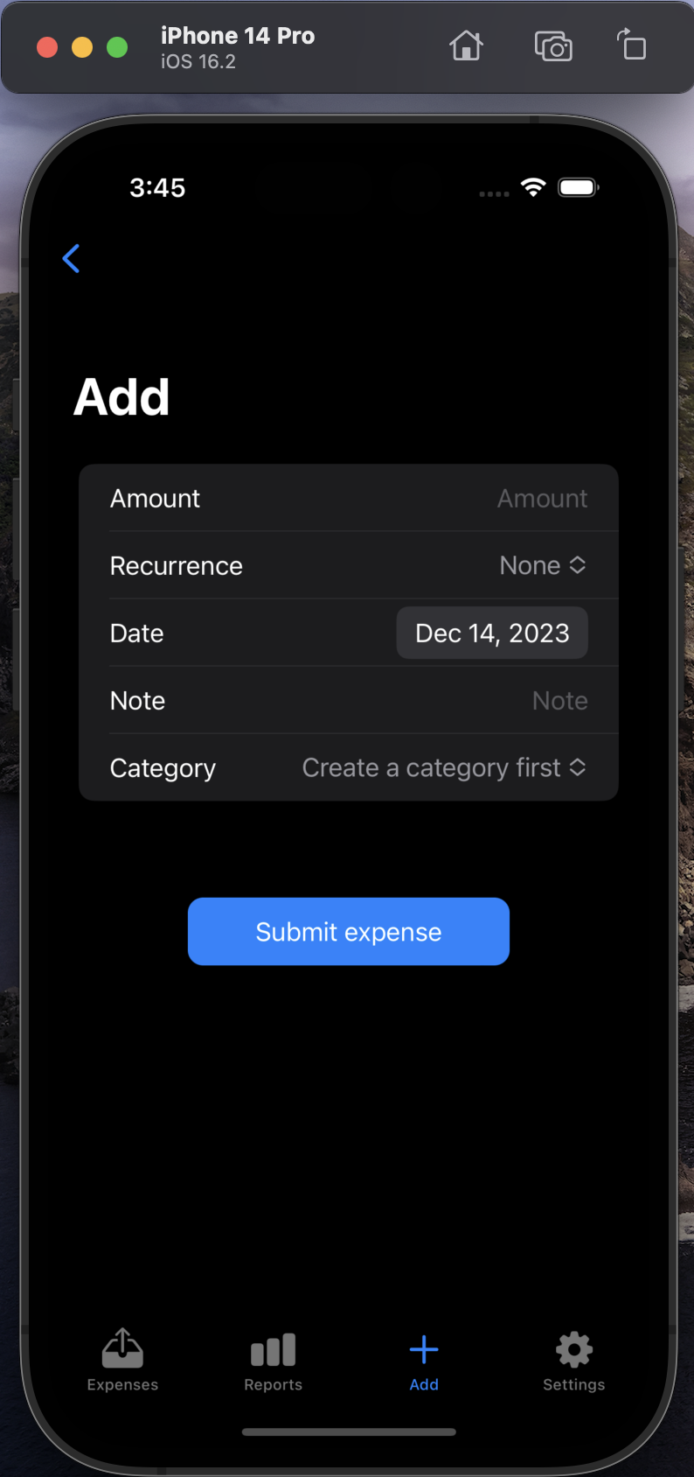
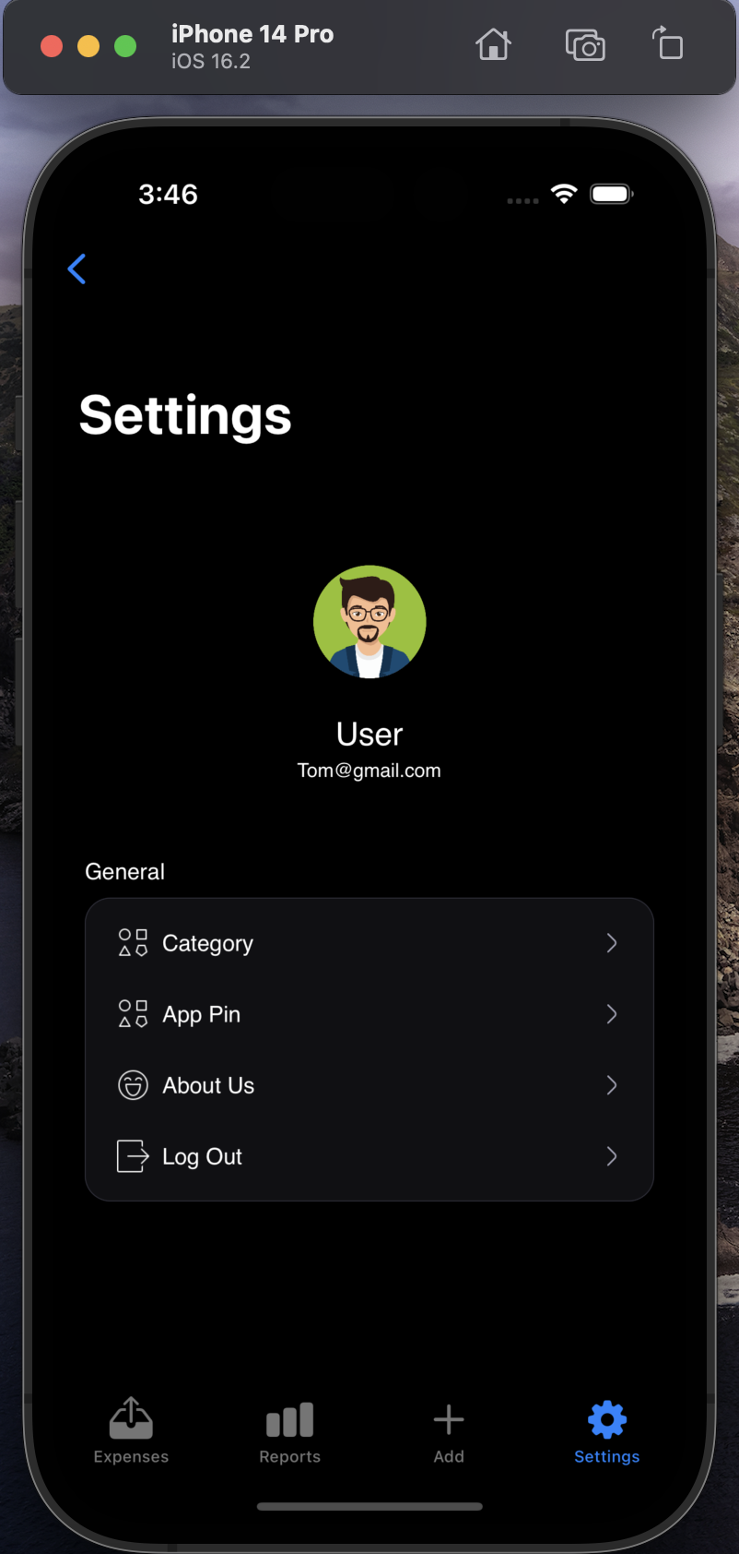
App Flow – 4 Tabs

Slide 9
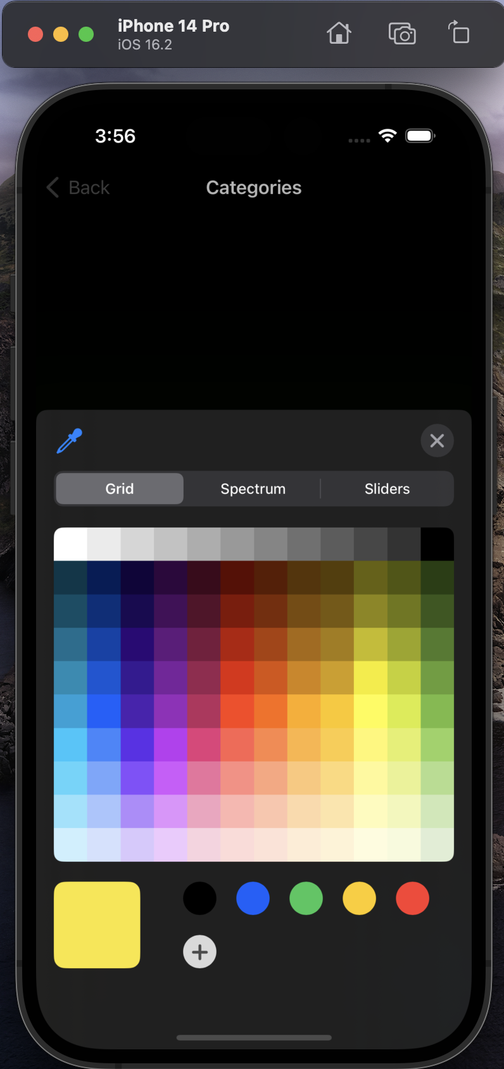
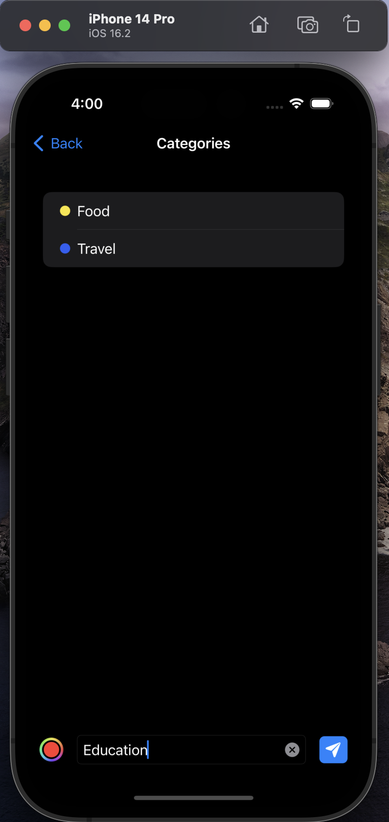
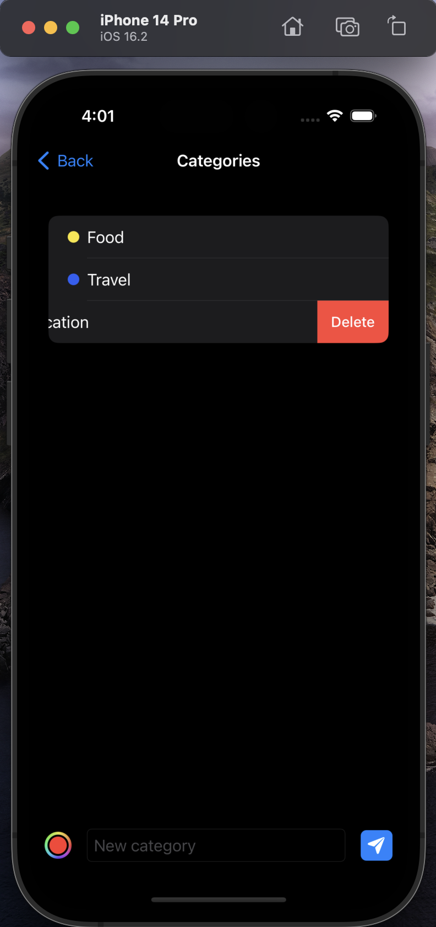
Categories

Slide 10
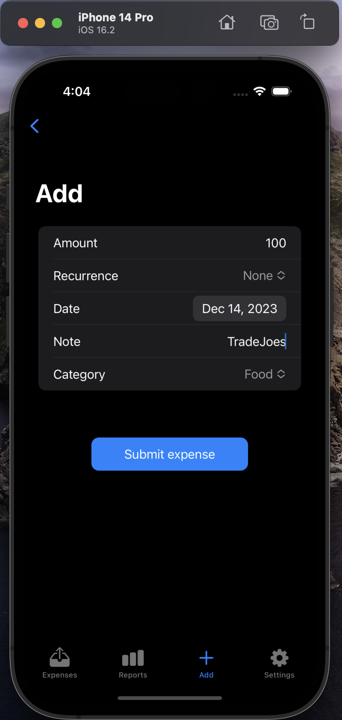
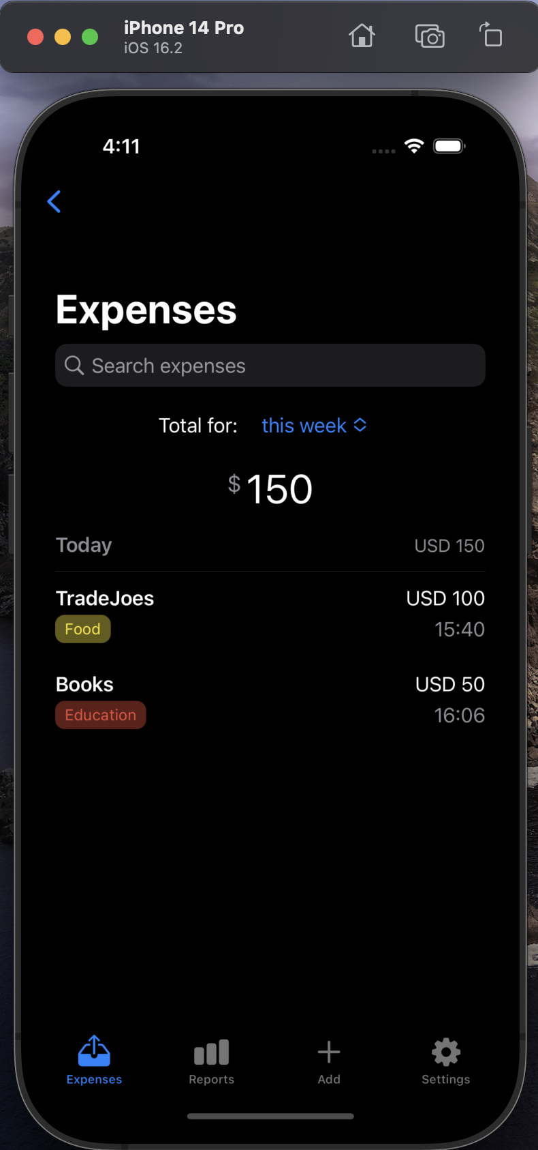
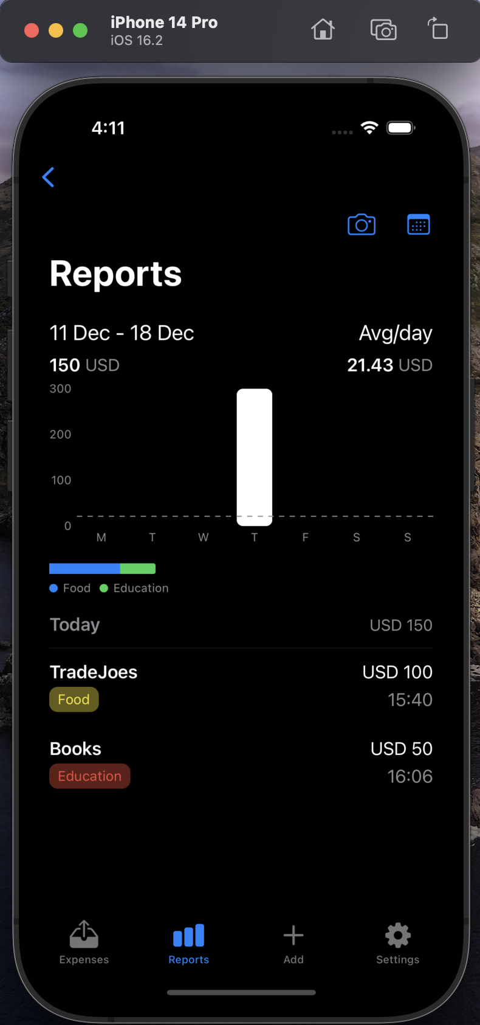
Expense

Slide 11
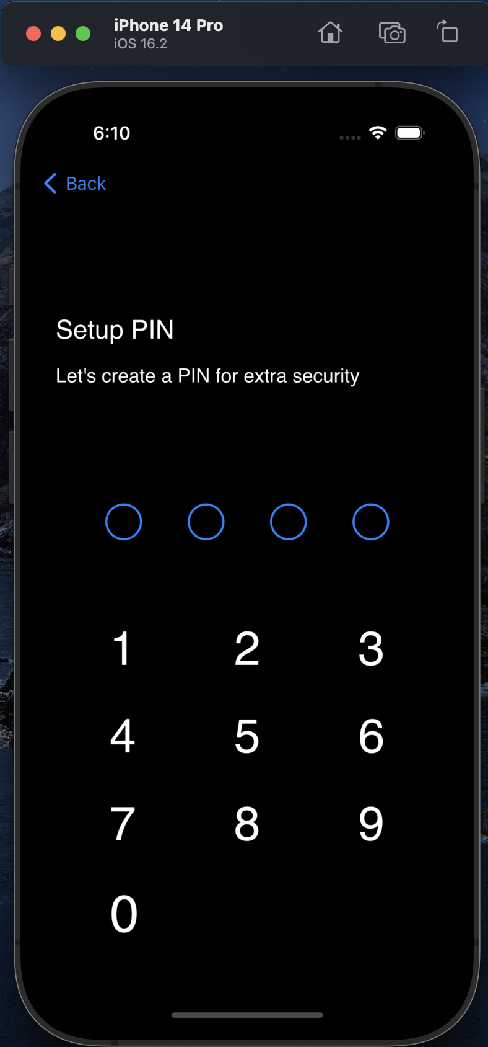
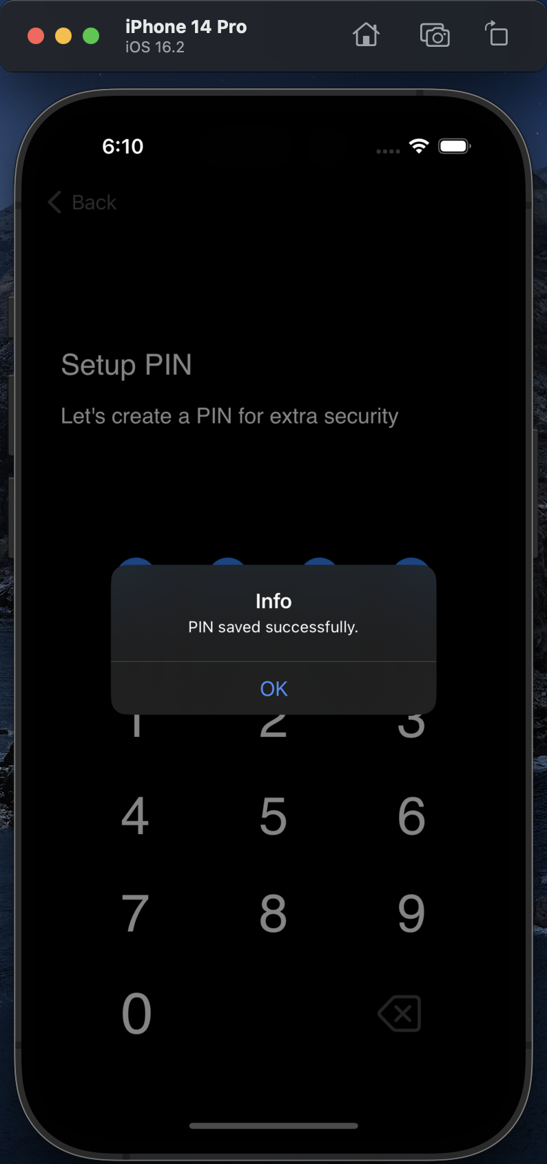
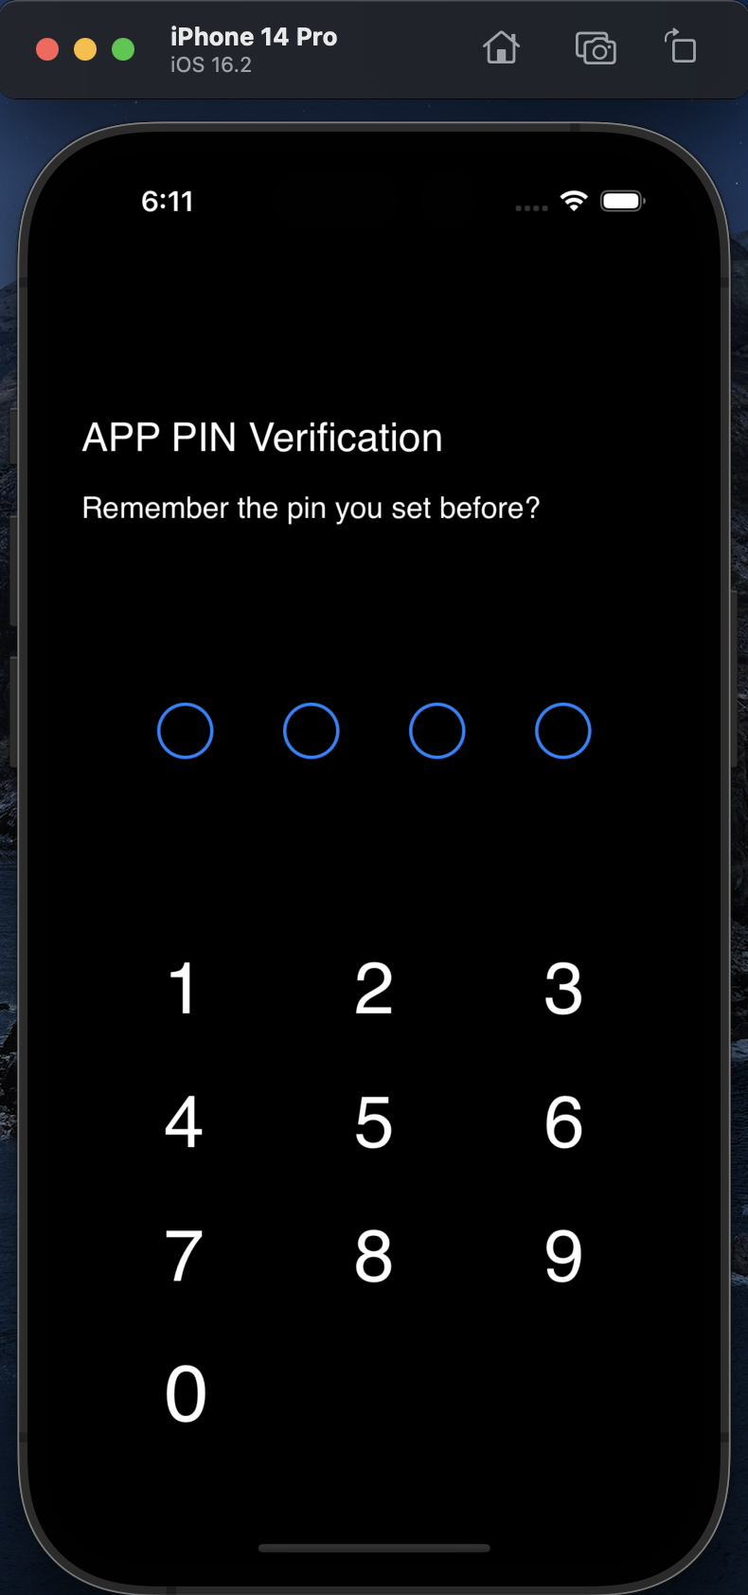
App Pin

Slide 12
Future Enhancement
Cloud Synchronization: Sync data across multiple devices, ensuring users always have access to the most recent transaction records.
Receipt Scanning & Uploading: Use the smartphone camera to scan and upload shopping or expenditure receipts, automatically extracting relevant data into the app.
Shared Expenditure Tracking: Record group expenses like partying and traveling in a common ledger, allowing for regular settlement among friends or co-renters, simplifying group financial management.

Slide 13
Thank you!

